Slide 1

Call center insight extraction and summarization

Slide 2



Automatic Transcription
Audio file
Whisper
Text file
Code snippet: https://github.com/mihaescurazvan/AIDaysHackathon/blob/master/CallCenterInsights/openaiWhisper.py

Slide 3
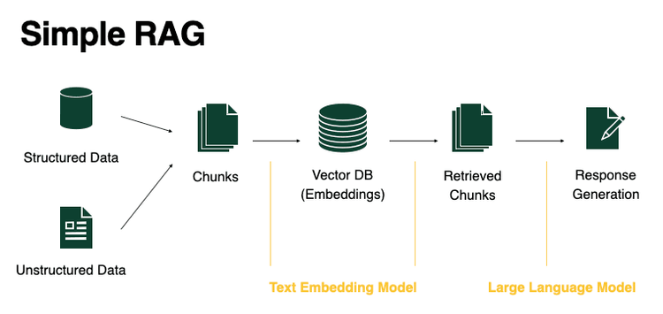


RAG
Others?
GRAG
Inv. Search

Slide 4
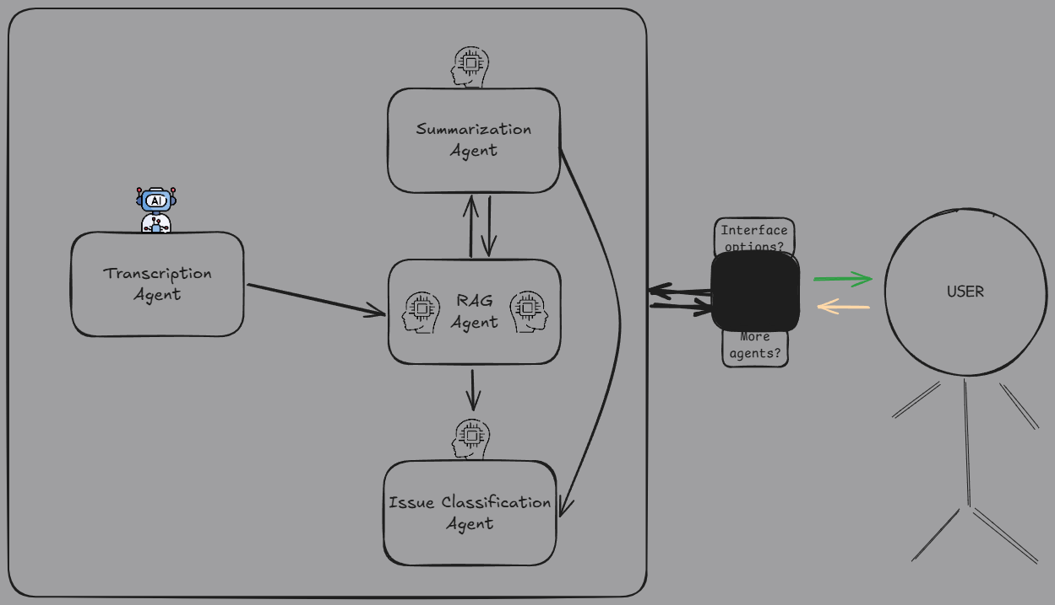

Slide 5
Datasets
Aggregate from multiple sources (https://archive.org/details/CallToMicrosoftIndiaCallCenter)
Angry customers? (https://www.youtube.com/watch?v=60EChndQZeU&list=PLPRnEVRV4d978hbZublYDSkKlTKB-iAmb&index=1)
Scams/Pranks ( https://www.youtube.com/watch?v=_6PF-sGBmu8&list=PL-h8WShBTzeJj1RZh9n5uIegbP7BaFBWS&index=2, https://www.youtube.com/watch?v=nGbQWejYtJw&list=PLgDwGY7k9zPGlVioGP02rSu6qCn1JE542&index=4)
Others:
https://sla.talkbank.org/TBB/ca/CallHome/eng (account needed)
Code snippet: https://github.com/mihaescurazvan/AIDaysHackathon/blob/master/CallCenterInsights/downloadYtb.py

